Slide 1
DEM Group Project
Group 11
Dataset- wbb_rosters_2022_23

Slide 2
The team
Alle Pranav Sudhan
Sreeshanth S
Sindhu Priya
Thanmayi
Data Pre-processing
Checked for any irrelevant columns and then removed them if necessary.
Checked for any inconsistent data types and converted them if necessary.
Made the Report
Helped in the PPT
Data Pre-processing
Data Analysis
Data Formatting
Data Visualisation
Labeled the axes appropriately and included titles for the visualization.
Interpret the results of the visualization and drew the conclusions.
Data Pre-processing
Data visualisation
Determined the research question.
Choose the appropriate type of visualization based on the type of data.
Used the matplotlib and created visualizations.
Helped in making the Report
Data Analysis
Explored the data.
Analyzed the dataset.
Data Preprocessing and then removed them if necessary.
Helped in making the Report
Made the PPT

Slide 3
Introduction
The dataset that was provided to us was based on basketball teams from various states and cities, and it contained details about the players, such as their height, name, position in the game, year in high school or college, among many others.
The given database has records for 13806 players from various hometowns with 30 columns or attributes.
Before deciding on the problem statements and the data that can be extracted from the dataset, we removed any unwanted columns where the data was already mentioned in another column or where it wasn't necessary.
Several columns in the dataset, like home state and position, record the same value in various ways. We eliminated such confusions (for instance, storing "California" and "Calif" separately when we may keep them together as one)

Slide 4
The problem
Problem statement 1
Problem statement 2
Problem statement 3
Figuring out top 10 homestates or hometowns which produces the greatest number of players.
Figuring which year (Sophomore, Freshman, Junior) produces maximum number of players.
Figuring out how the number of players on each team vary across different conferences and divisions.

Slide 5
The Analysis and Visualisation

Slide 6
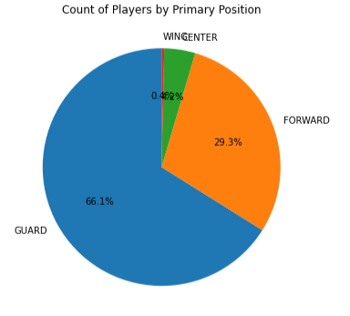
Data Analysis
Pie Chart for count of players by Primary Position

Slide 7
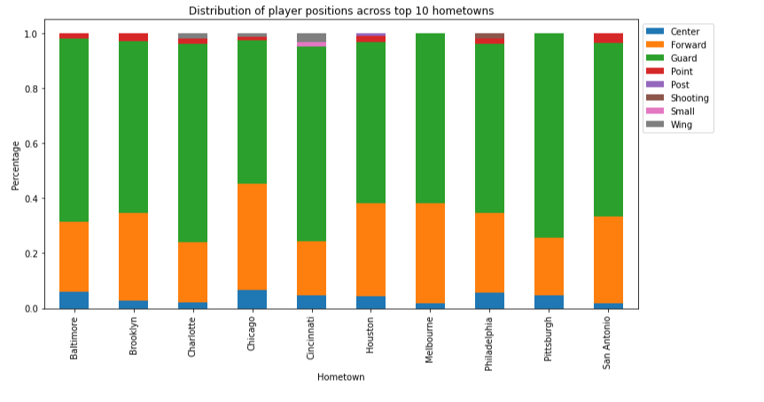
Data Analysis
To investigate the distribution of player positions across the top 10 hometowns of athletes.

Slide 8
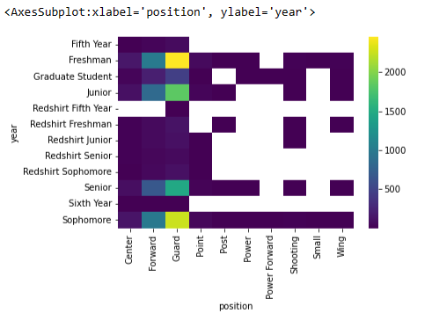
Data Analysis
To investigate the correlation between year of the player and their position in basketball.

Slide 9
PS-1
Figuring out top 10 homestates or hometown which produces the greatest number of players.
To depict the number of players from each year, we use a bar plot.
We then count the number of participants in each group after organizing the players by year.
The number of players in each year can be visualized using a bar plot, which makes it easy to see how the numbers fluctuate from year to year. The height of each bar, which represents a year, reflects the number of players in that year.
This makes it simple to determine which year has the most players. A bar plot also enables us to compare player counts across several years at once.

Slide 10
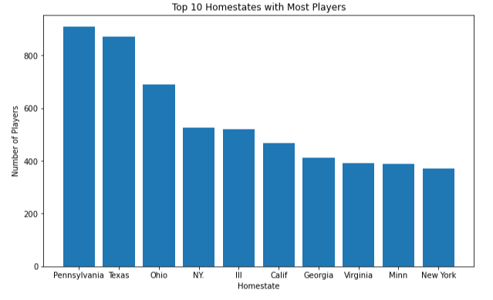
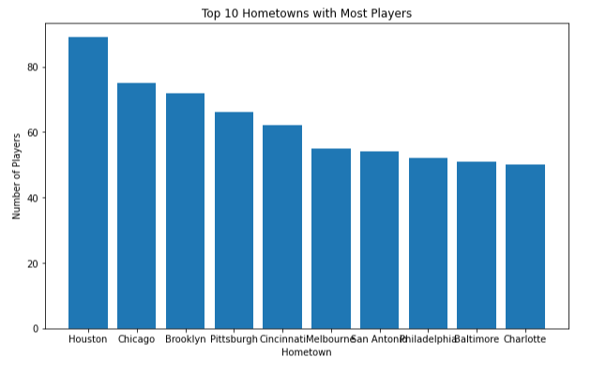
Visualization of PS-1

Slide 11
PS-2
Figuring which year (Sophomore, Freshman, Junior) produces maximum number of players.
To figure out which year (Sophomore, Freshman, Junior) produces the maximum number of players, we need to collect data on the players and sort it based on their year.
Then, we can calculate the total number of players in each year and create a graph to visually represent the data.
We should analyze the data, consider any external factors that might be affecting it, and draw conclusions about which year produces the maximum number of players and any contributing factors.

Slide 12
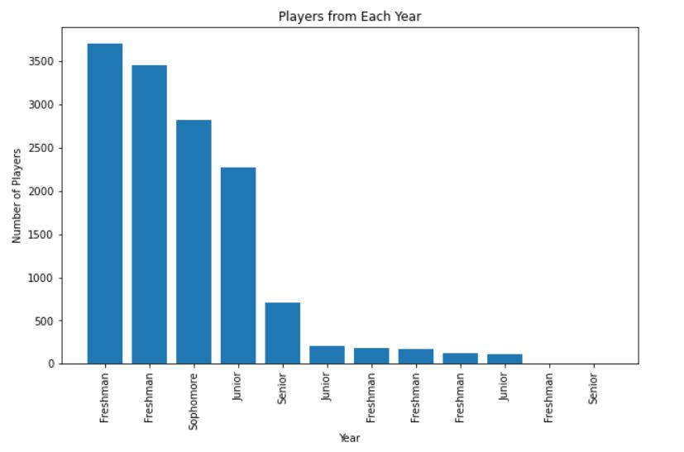
Visualization of PS-2

Slide 13
PS-3
Figuring out how the number of players on each team vary across different conferences and divisions.
To figure out how the number of players on each team varies across different conferences and divisions, we need to collect data on the players and sort it based on their team's conference and division.
Then, we can calculate the average number of players per team in each conference and division and create a graph to visually represent the data. We should analyze the data, consider any external factors that might be affecting it, and draw conclusions about how the number of players on each team varies across different conferences and divisions and any contributing factors.

Slide 14
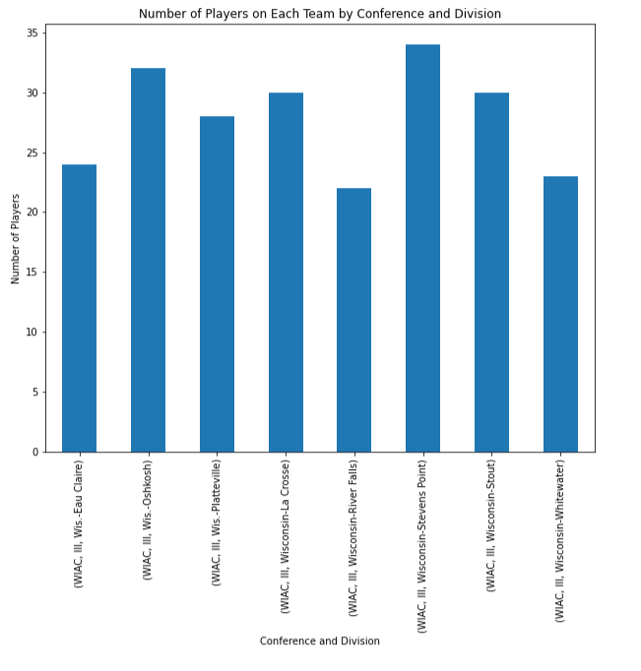
Visualization of PS-3

Slide 15
Thank You

